Slide 1
Programmable Web Project
Course Description
Spring 2026
521260S
5 ECTS
Staff: Mika Oja
Iván Sánchez
pwp-course@lists.oulu.fi

Slide 2
Table of contents
Goals, learning outcomes and content.
Course implementation
Platforms
Deadlines
Evaluation
Project work in Brief
Miscellanea

Slide 3
Course goal
This course aims to provide adequate knowledge to design, implement, test,document and deploy a Web API.

Slide 4
Learning outcomes
Identify different Web API architectures and technologies (e.g. REST, RPC and event-driven architectures) being able to select the most appropriate for a system implementation.
Understands Web API design principles and knows how to implement Web APIs using existing Web frameworks
Evaluate Web API solutions being able to execute unit and functional testing for Web APIs

Slide 5
Learning outcomes
Document Web APIs utilizing existing software tools (e.g. OpenAPI).
Create clients or other services consuming the API.
Deploy the Web API in the cloud

Slide 6
Course content in Practice
Introduction to concepts that are present in modern web development
  (Relational) databases, APIs, web frameworks
Understanding and designing interfaces for communication between services
  Different types of APIs
  REST APIs
  Hypermedia
Implementing web APIS and clients with Python
  Using lightweight frameworks and libraries that do not hide too many details
  Other technologies can be used in the course project as well
Deploying a Web API in the cloud

Slide 7
WHY THIS COURSE?
This course serves as an introductory course to API design and development
  Helps to develop BACKEND DEVELOPER SKILLS
Full work cycle
  Design, implementation, documentation, test and deployment
  Several iterations based on customer (course staff) feedback
  This work resembles quite a lot the way of working in IT
Team work (3-4 people)
  You need to define roles
  You need to manage time.

Slide 8
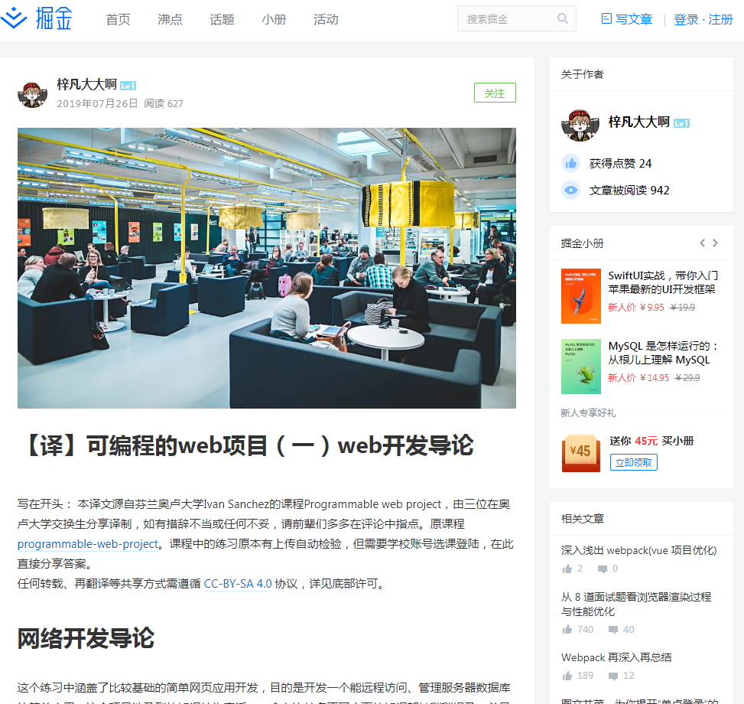
Notes:
https://juejin.cn/post/6844903897543213064

Slide 9
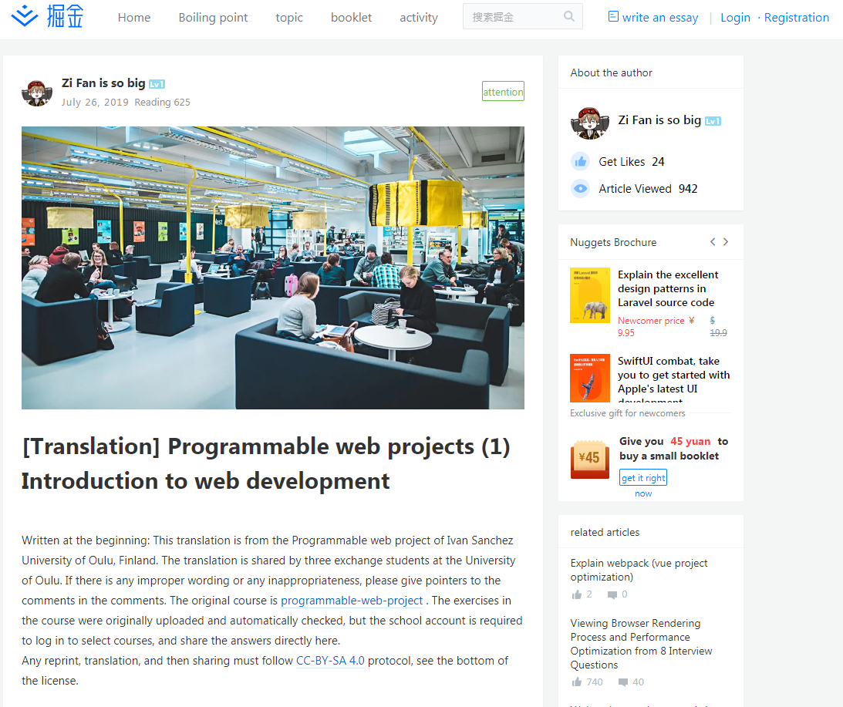

Slide 10
Course implementation
Practical approach
Project work: Students design, document, implement, test and deploy a RESTful Web API.
  Students implement small set of services
  Interfaces between services will be documented
  Different deadlines with intermediate feedback from course staff
Students will work in GROUPS to practice the necessary communication and cooperation skills

Slide 11
Course implementation
Practical approach
Lecture at the begining of the course provides the theoretical background
  Lecture 1: Introduces Web Concepts
  Lecture 2: Focus in APIs and introduces microservices
Exercises provides necessary grodund work form implementing the project (workflow, toolchain, architecture...)
  Each exercise is an online tutorial with several tasks
  Each exercise deal with some aspect of the course project

Slide 12
Lecture
4 hours lecture (2+2 hours)
Lecture 1:
  Services and APIs
  Programmable Web
    Definition and concepts
  Technologies for the Programmable Web
    Databases
    HTTP
    Representation format: JSON, XML and Hypermedia
    Web Clients
Lecture 2:
  Web APIs and Hypermedia
  Brief introduction to microservices

Slide 13
Exercises (I)
4 mandatory exercises
  Schedule in Tuudo / Peppi
Exercises instructions and tasks, as well as return box for the different tasks are available in Lovelace.
Each exercise has two different parts:
  Theoretical lecture
  Q&A session (Computer rooms)
    Course staff always present to answer student questions / providing tips …
    You can do part of the work during the Q&A session BUT you won’t have time to complete the whole exercise in the given time.
    Attending and participating actively in the Q&A sessions will provide extra points.

Slide 14
Exercises (II)
Exercise 1: Introduction to Web Development.
Exercise 2: Implemententig REST APIs with Flask.
Exercise 3: API documentation and deployment.
Exercise 4: API consumption

Slide 15
Material and resources. Bibliography.
Books:
  Leonard Richardson, Mike Amundsen, Sam Ruby. RESTful Web APIs. O'Reilly Media, 2013. ISBN: 978-1-4493-5806-8
  Leonard Richardson & Sam Ruby,RESTful Web Services. O’Reilly Media 2007. ISBN: 978-0-596-52926-0. Free available at http://restfulwebapis.org/rws.html
  An electronic version of the books are accessible through Oulu University Library catalogue.
Lecture and lab slides.
Extra study material will be provided during the course through Lovelace.

Slide 16
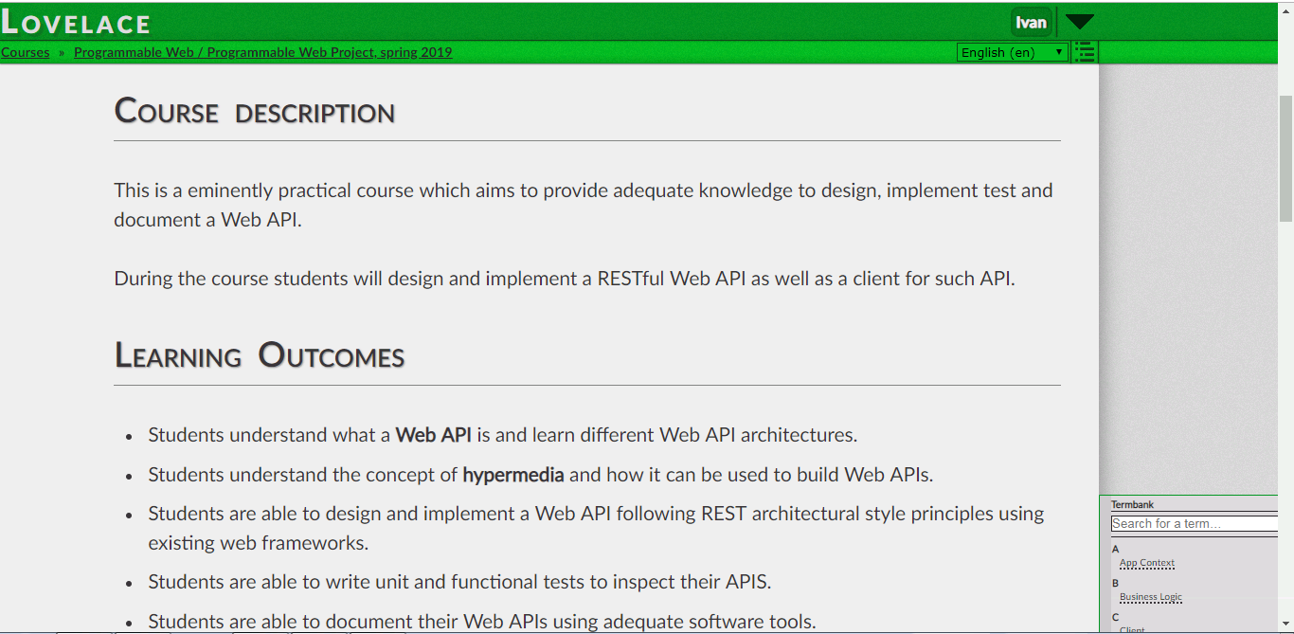
Platforms. LOVELACE
http://lovelace.oulu.fi
Learning material
Exercises instructions
Return box for exercises and project deadlines
Adminstrative tasks (group creations, meeting reservations…)

Slide 17
Platforms. LOVELACE
Enrolling in Lovelace
Creating teams
Booking meeting times
Returning exercises questions
  Asking for help from course staff
Returning project work

Slide 18
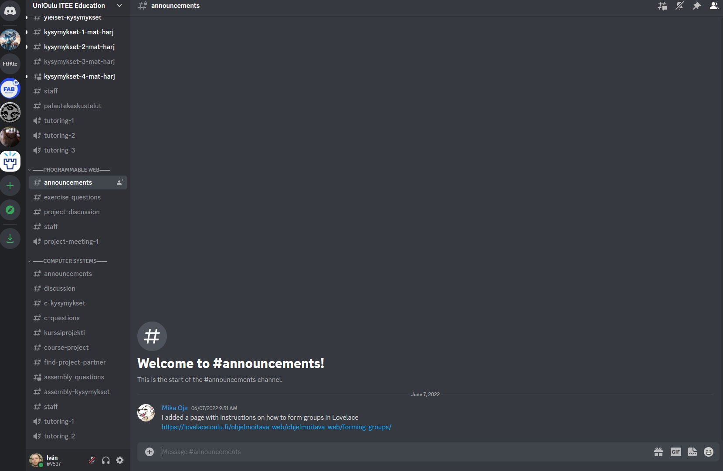
Platforms. Discord
Announcements from course staff.
“Instant” communication and feedback. Discussion

Slide 19


Platforms. Github / Gitlab
GitHub
https://github.com/
GitLab
https://about.gitlab.com/
Project documentation
Project code
Meeting notes

Slide 20



Platforms.Team communication

Slide 21
Project Work (I)
In this project students design, implement, document and test:
  A functional RESTful API:
    Meets REST principles, using the ROA architecture.
    Stores persistent data in a database (relational or not relational).
  A Client application that uses the Web API functionality:
    It is composed at least by:
      An HTTP client to access the RESTful API
      A GUI / command tool (non-human driven clients accepted after contacting the course staff)
  An auxiliary service that communicates with the API and the client.
    Performs operation that should be separated from API server
    Does not need to be a REST service.
More detailed requirements for the REST API, the client and the auxiliary service in Lovelace
Services should be deployed in the cloud in order to get full points

Slide 22
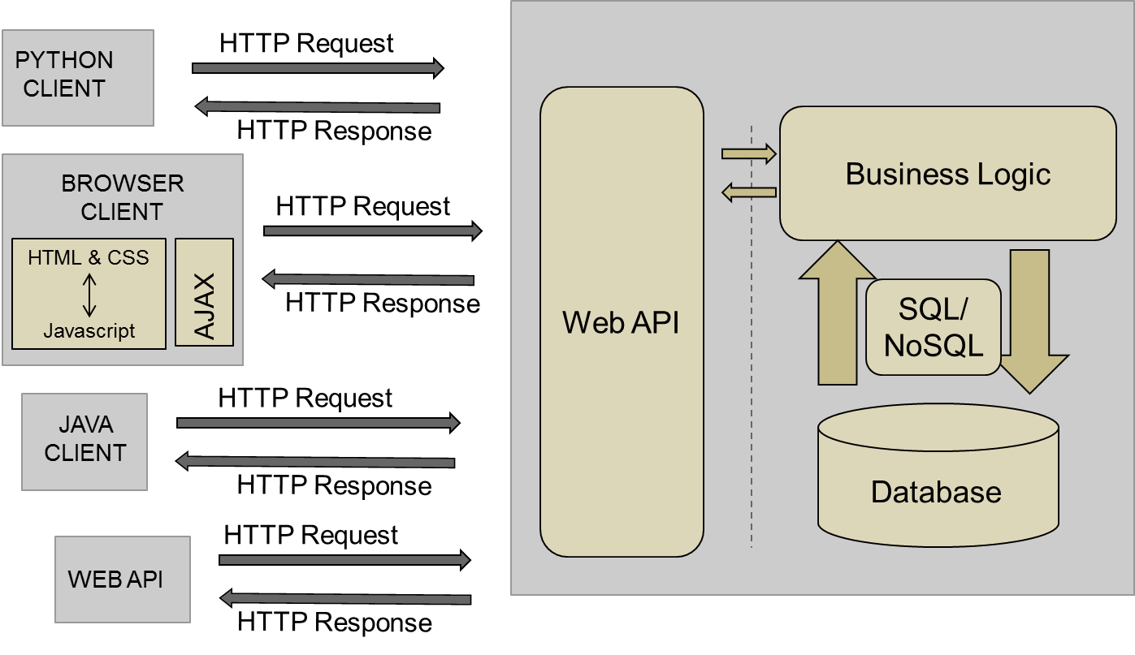
Project Work (II)

Slide 23
Project Work (III)
The project must be done in groups of three / four people.
  BE ACTIVE IN THE SEARCH OF A PARTNER
  Use Discord to find a partner. We will open a channel for that purpose.
    Advertise your interest and the grade you are aiming for.
One group member creates the group in Lovelace and invite other group members
  If student created their own group cannot be invited to another group
  Students cannot remove students from groups. Contact course staff.

Slide 24
Project Work in Brief (IV)
OPTION 1:
Deadlines
The project is divided in 6 deadlines
Meeting with course staff after deadlines 1-4
Missing one deadline -> automatically move to option 2
OPTION 2:
Final deliverable
All the project content is delivered by the final deadline
  One intermediate meeting with staff is required

Slide 25

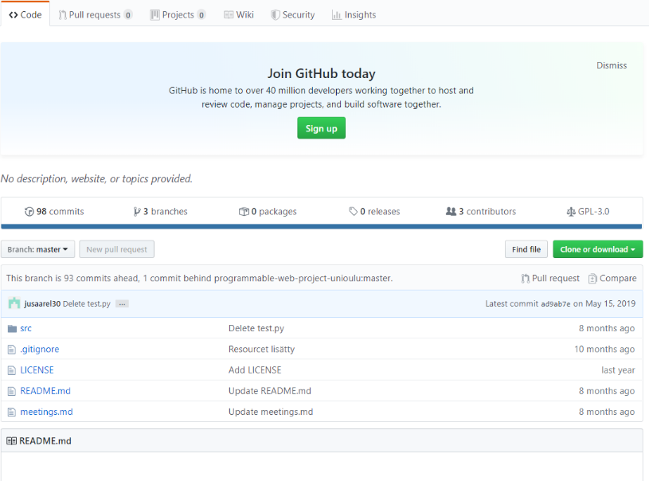
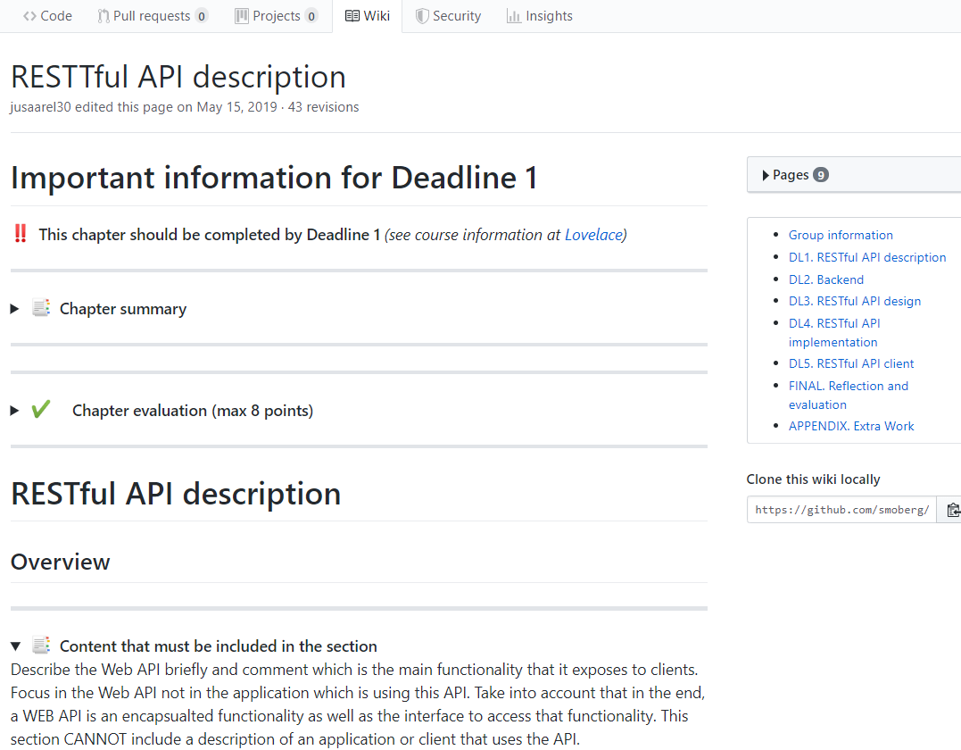
Project work (V).
You need to use a GIT repo to upload your code and documentation
GitHub: https://github.com/
GitLab: https://about.gitlab.com/
Use the GIT repo for the code and the Wiki to document your project
CLONE the GITHUB/GITLAB repo we provide. It contains the template for the documentation

Slide 26
Major Deadlines (Project)
Deadline 0 (19th Jan) : FOR ALL STUDENTS
  Register the group and project topic in Lovelace
Deadline 1: TBD
Deadline 2: TBD
Deadline 3: TBD
Deadline 4: TBD
Deadline 5: TBD
Deadline 6: TBD
Students present the work done during the deadline in a meeting to the course staff.
NOTE: Experienced or otherwise confident groups who have trouble scheduling for the deadlines can do one final delivery instead.
  Students taking this option should have a midterm meeting with staff. Schedule will be assign later.

Slide 27
Major Deadlines (Project)
Deadline 0 (19th Jan 2026): FOR ALL STUDENTS
  Register the group and project topic in Lovelace
Deadline 1: Project Plan (26.01.2026)
Deadline 2: Database (09.02.2026)
Deadline 3: API basic implementation (02.03.2026)
Deadline 4: API documentation and deployment (06.04.2026)
Deadline 5: API use / consumption – Client + Auxiliary service (27.04.2026)
Deadline 6: Final deliverable – Project reflection and feedback (03.05.2026)
Students present the work done during the deadline in a meeting to the course staff.
NOTE: Experienced or otherwise confident groups who have trouble scheduling for the deadlines can do one final delivery instead.
  Students taking this option should have a midterm meeting with staff. Schedule will be assign later.

Slide 28
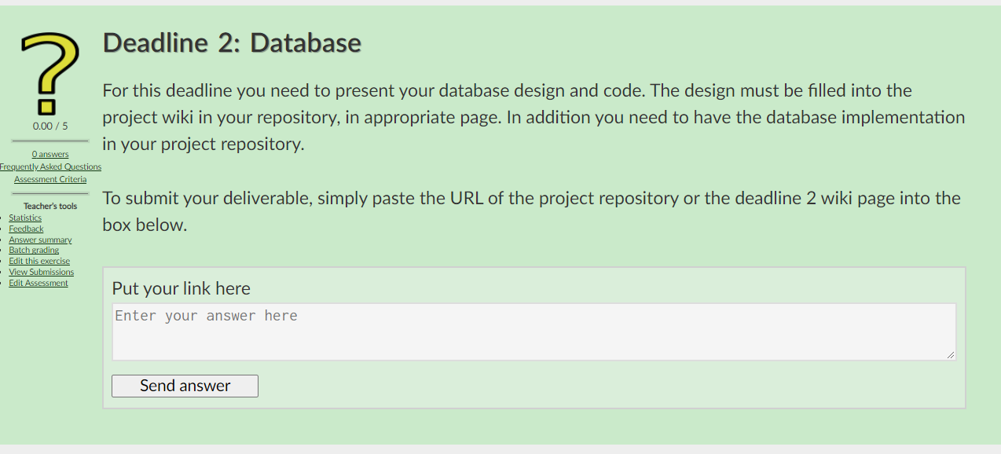
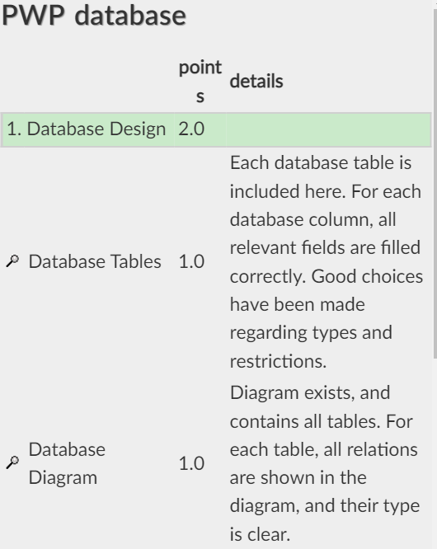
Project Work (VI)
Before each deadline you must return in the corresponding Lovelace return box:
  The link to your project wiki
  The link to the repository
You can check the assessment criteria for each deadline in Lovelace

Slide 29
Major Deadlines (Exercises)
Exercises deadlines
Exercise 1. 29.01.2026
Exercise 2. 19.02.2026
Exercise 3. 26.03.2026
Exercise 4. 09.04.2026
Delivering exercises late will have a penalization in the grade
Attending to the Q&A for at least one hour will give you 1 extra point.

Slide 30
Assessment (I)
Project Work Topic | Deadlines | Points (out of 100) [*]
Project plan | D1 | 5
Database | D2 | 5
API Basic Implementation | D3 | 21
API Documentation and deployment | D4 | 19
API consumption | D5 | 25
Project reflection and feedback | D6 | 5
Project management and participation | - | 4
Exercises | - | 16
* NOT DEFINITIVE
The final grade is obtained adding up the points of each deliverable.
  Improving the deliverable by the final deadline => Increase the grade
More accurate grading information will be published later in Lovelace

Slide 31
Assessment (II)
Grade 1::
  Complete first two exercises fully
  Implement a functional API server with basic features
  Document your API
Grade 2:
  Complete first three exercises fully
  Implement an API server with most graded features
  High quality code base and documentation
Grade 3:
  Complete all exercises
  Implement a functional API server and a functional client for it
  Document your API
Grade 4:
  Complete all exercises
  Implement an API server with most graded features
  Deploy the service in the cloud
  Document your API
Grade 5:
  Same as 4, but also implement the third component
Notes:
Project Work document: APP_1_ Project_Work.ppt and Project Work Assigment.pdf

Slide 32
Use of AI
FORBIDDEN to generate exercise code.
FORBIDDEN for writing the project report
  AI can be used just to correct grammar, but text MUST BE GENERATED BY STUDENT . We will take special care in Section 1 (DL1. API description) and Final section (Reflection and Feedback)
  Any section with text in the project report clearly written by an AI is rejected and not assessed.
ALLOWED WITH RESTRICTIONS: To generate proced code
  Students report: AI tool used, Prompts, explain how code was modified
  The AI must be a free tool that's freely accessible or provided by university.
  If student use AI, they are fully responsible of the code they generated. Students MUST UNDERSTAND THE GENERATED CODE.

Slide 33
Use of AI
The use of AI should be included in the report in each deliverable. If not included the correspondent deliverable wont be assessed.

Slide 34

Questions

